Slide 1
Investigating the Underlying Relationships in Body Dimensions
Dan Huang
Virginia Commonwealth University
04/25/2018

Slide 2
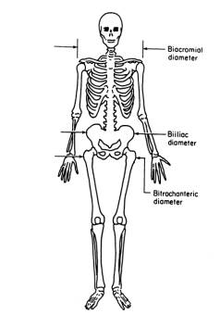
Data Introduction
Size: 507 observations, 25 variables
Variables: 9 skeletal variables, 12 girth variables
Other measurements: age, weight, height, gender
No missing values
The goal of this report is to investigating the relationship in the body build dimensions for commercial business or art of designs.

Slide 3
Main Methods
Principle Component Analysis
Factor Analysis
Multiple Linear Regression
Logistic Regression
Linear Discriminant Analysis
Quadratic Discriminant Analysis
K-Nearest Neighbors
Classification Trees
Bagging
Boosting
Random Forest

Slide 4
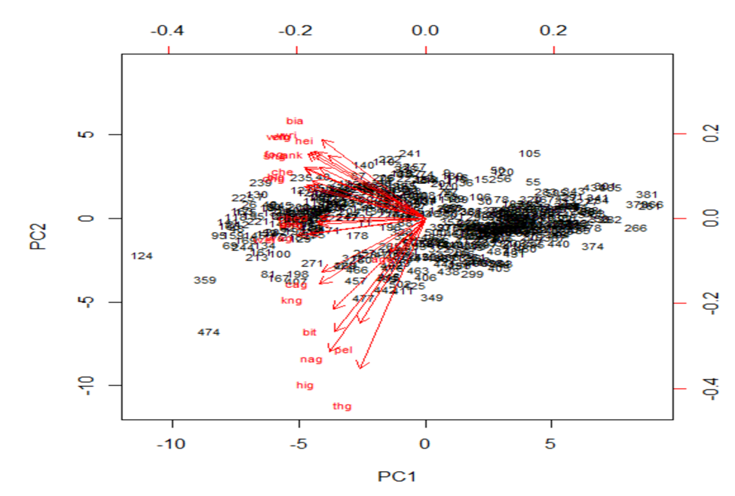
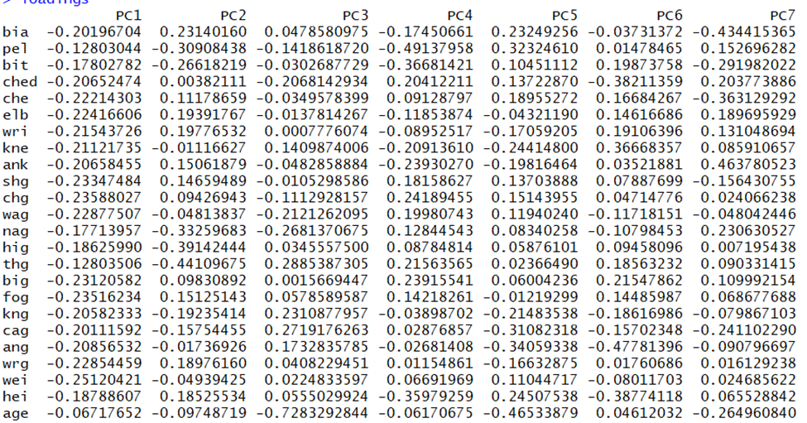
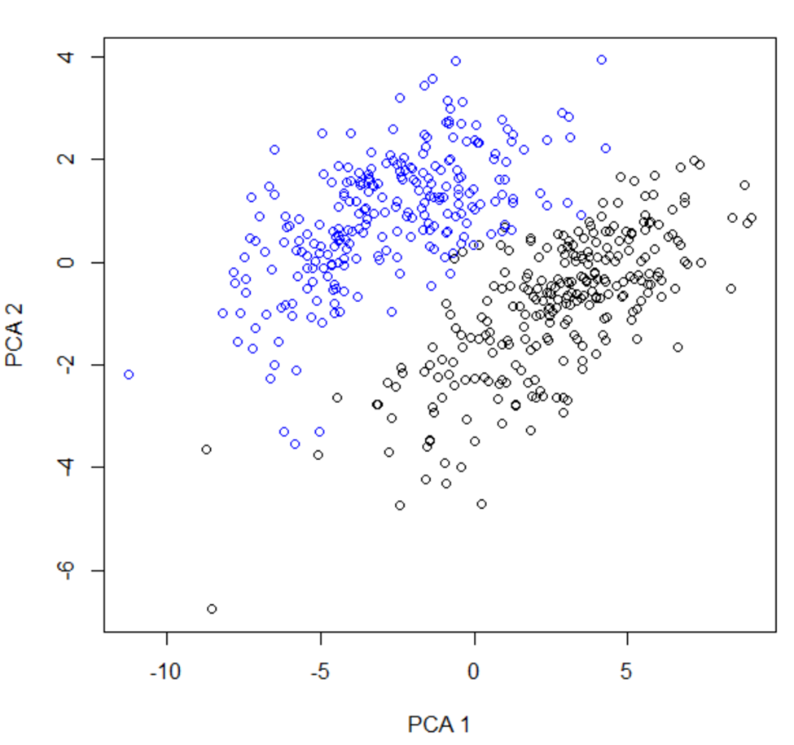
Principle Component Analysis
The first 8 principle components can explain 90.481% of the total variances which is good.

Slide 5
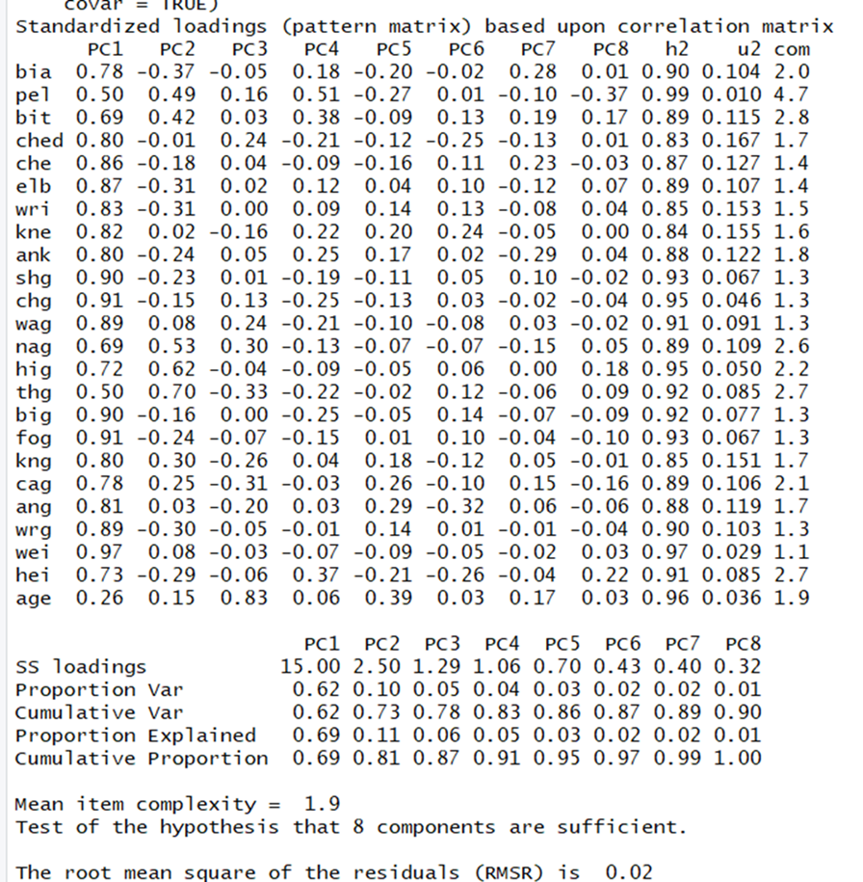
Factor Analysis
First factor could be considered girth build factor; the second factor could be considered thigh girth factor; the third factor could be considered as age factor. Compared with the communities of the two factors analysis, the communities of the eight factors analysis are much better. Moreover, the p-value of chi square test is less than 0.86, which implies that null hypothesis can not be rejected and conclude that the eight-factor model is adequate.

Slide 6
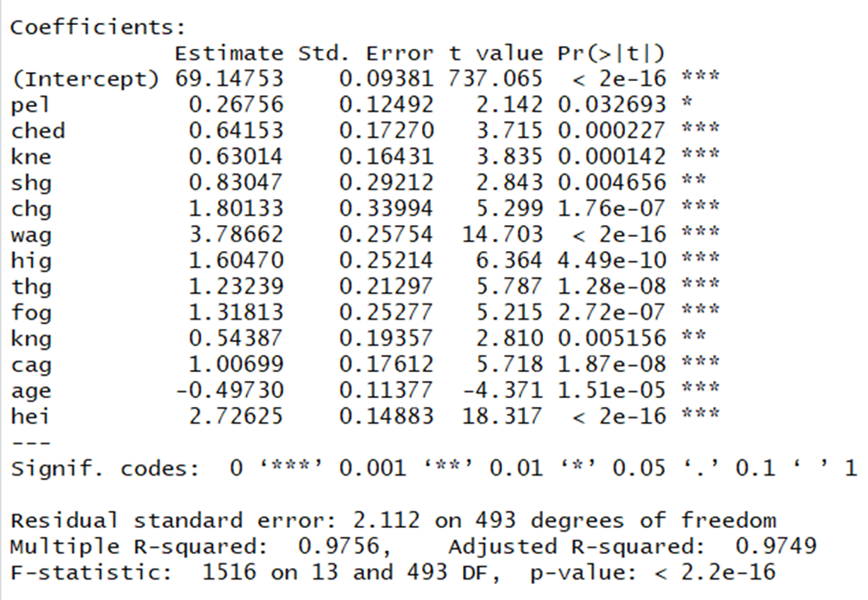
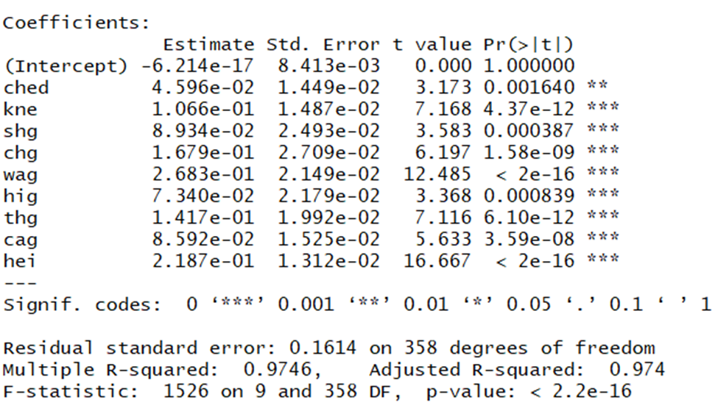
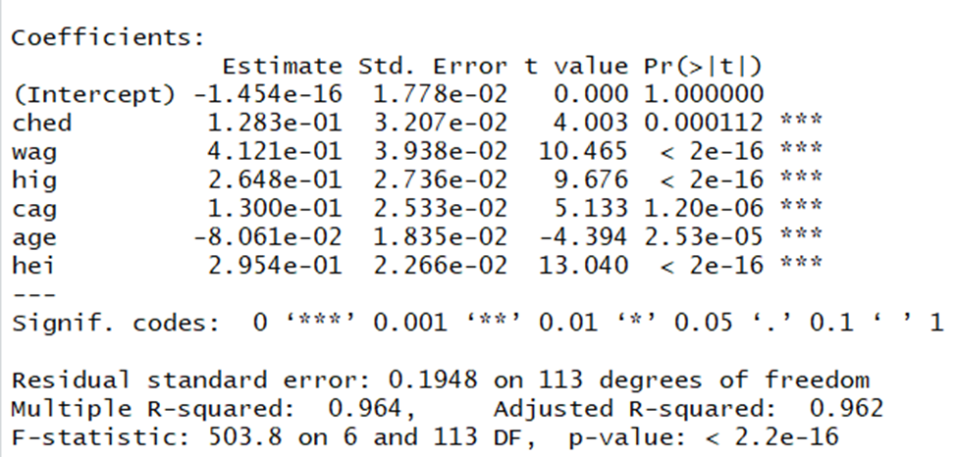
Multiple Regression Models
a)Weight= 69.148-1.059bia+0.876pel+1.816bit+4.546ched+4.1686che+1.444wri+2.23kne-0.895age+1.794hei
b)Weight= 69.148+0.73212shg+2.07chg+3.966wag+1.762hig+1.27thg+1.511fog+0.751kng+1.126cag-0.356age+2.997hei
In the young group, the people from age 18-35 don’t change too much on the weight with other skeletal and girth variables. It shows that increasing the age from 36 will have negative influence on weight.

Slide 7
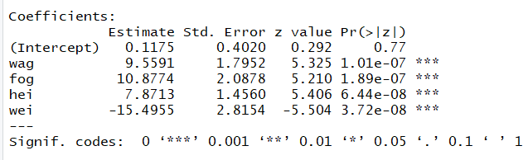
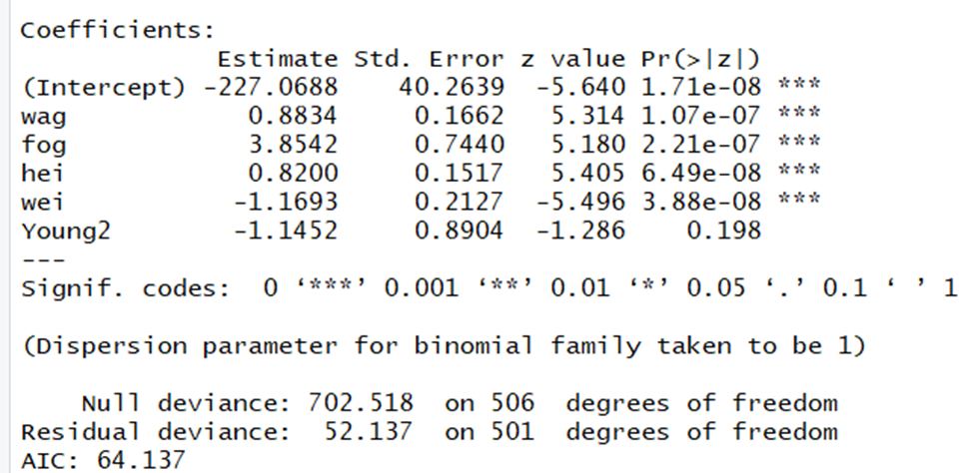
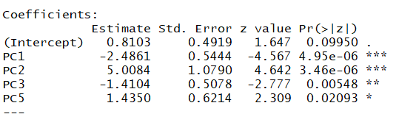
Logistic Regression Models
PCA: good, 1.78% misclassification error rate
Reduced the regression: all insignificant, 2.17% misclassification error rate
Now I take two age groups into account to classifications in the model. The misclassification error rate is 2.17%, which is the same in the previous model because the Young variable is not significant in the model.
Classification by age groups: APER=41.42%

Slide 8
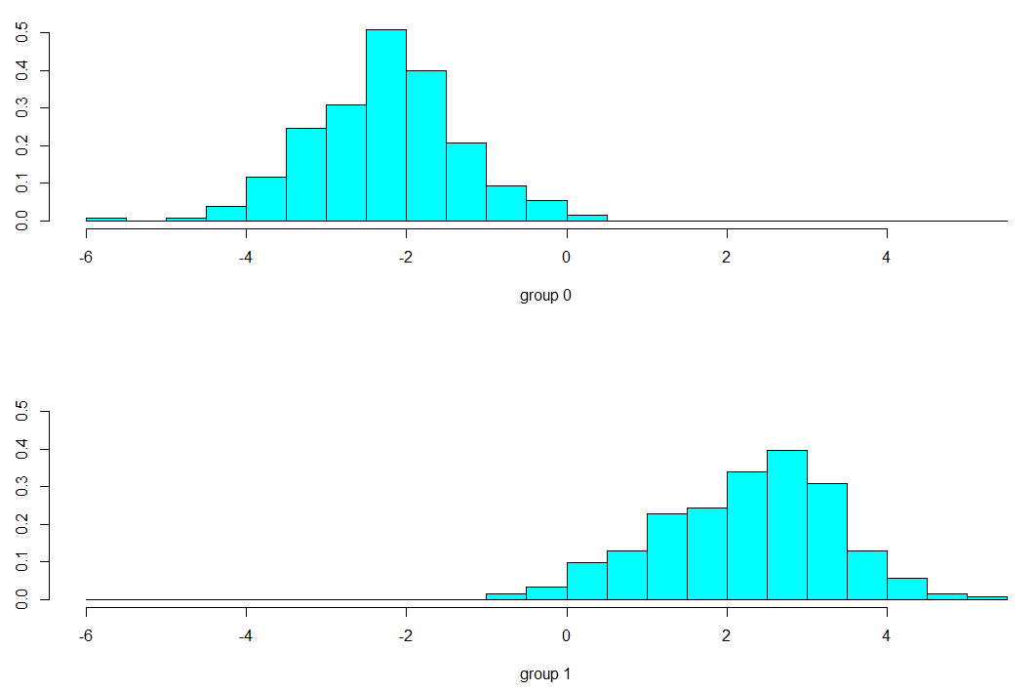
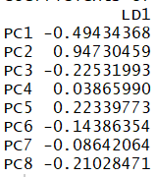
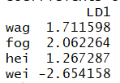
Linear Discriminant Analysis and Quadratic Discriminant Analysis
LDA: with significant terms to fit, misclassification error rate is 2.76%
with PCA method to fit, misclassification error rate is 1.58%
QDA: Fitting the model with significant terms, the misclassification rate is 2.96%
Fitting the model with PCA method, the misclassification error rate is 1.78%.

Slide 9
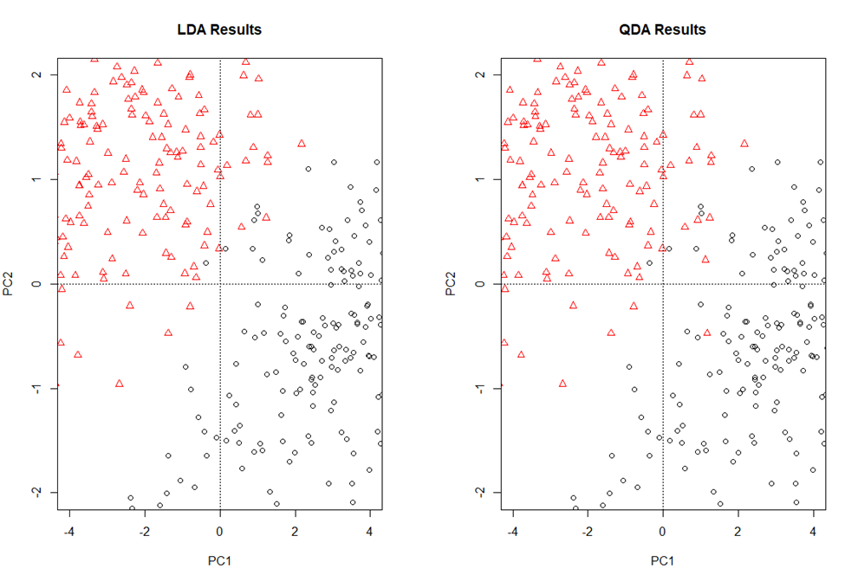
PCA, LDA and QDA
Obviously, the LDA and QDA results demonstrate the separation in males and females well even though there are few observations misclassified from the plots.
PC1 is good discriminant.

Slide 10
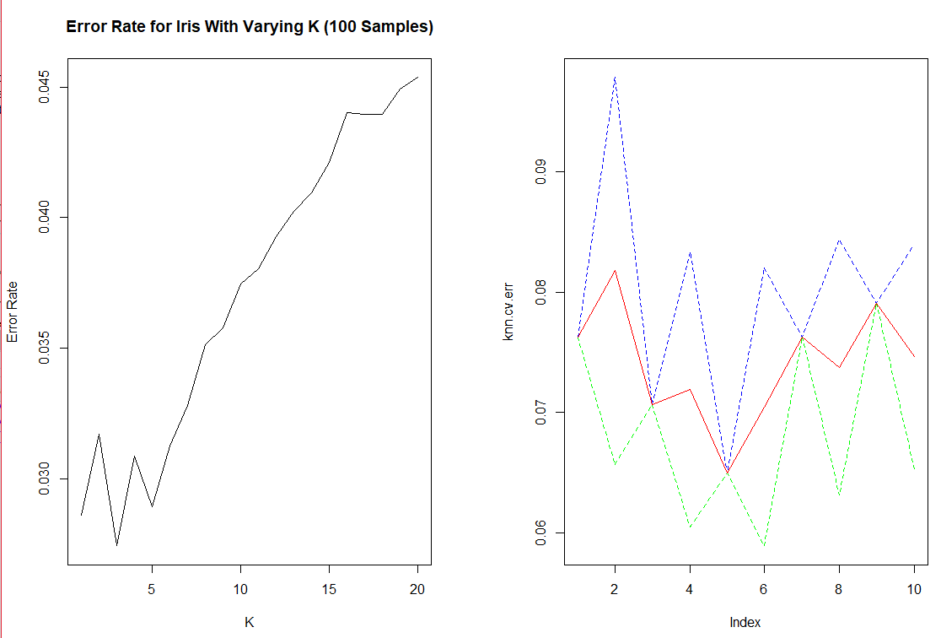
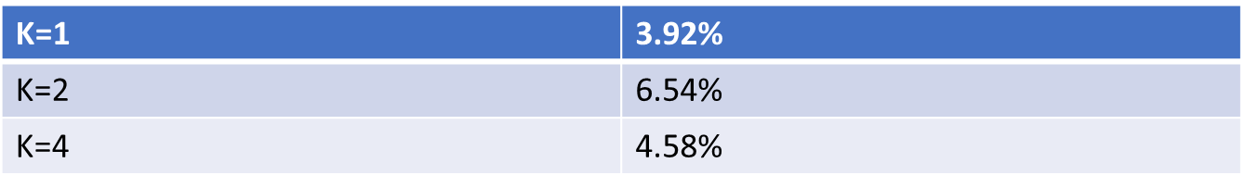
K-Nearest Neighbors
Take 70% of the sample as the train dataset, 30% of the sample as the test dataset.
Test the significant terms: waist girth, forearm girth, weight and height
When K=5, the misclassification error rate is 5.23%.

Slide 11
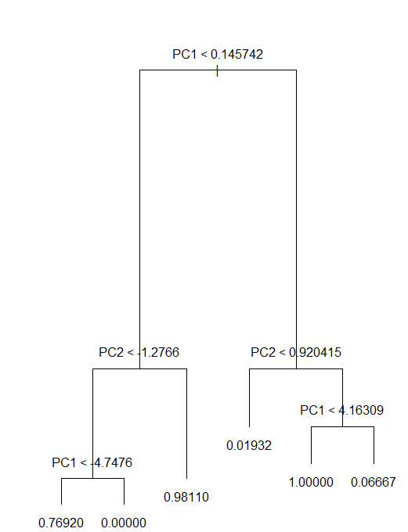
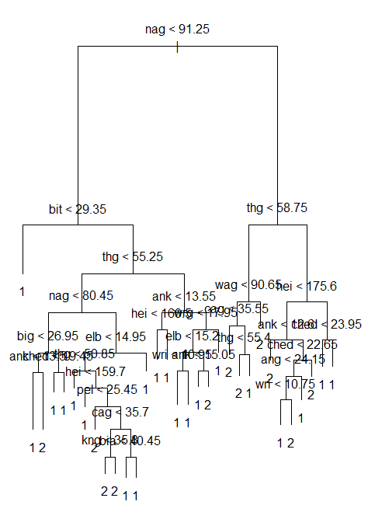
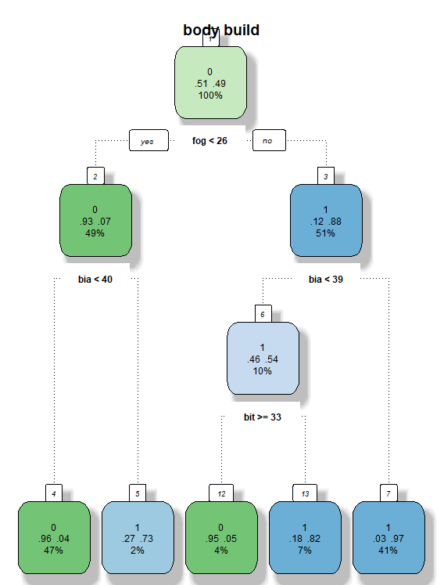
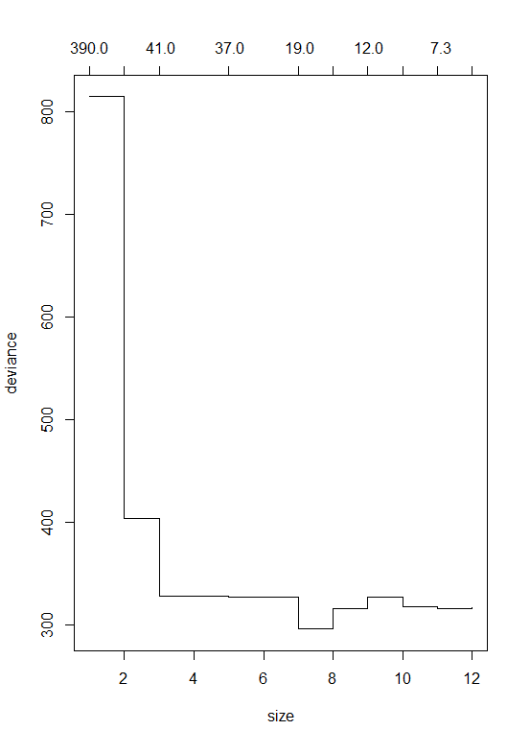
Classification Tree
Fitting the complete model by using standardized data, APER is 1.38%. After pruning the tree with size 8, APER is 2.17%.
Gini method: APER is 3.75%.
Take two age groups into account, APER is 9.67%.
Gini method: APER=11.24% taking age groups.
Take PCA method: APER=2.213%.
PC1 and PC2 are the most important splitters.

Slide 12
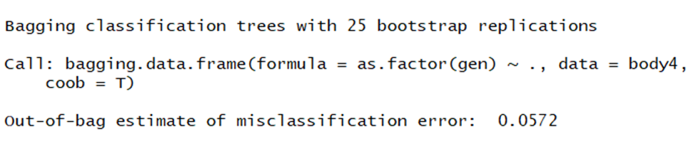
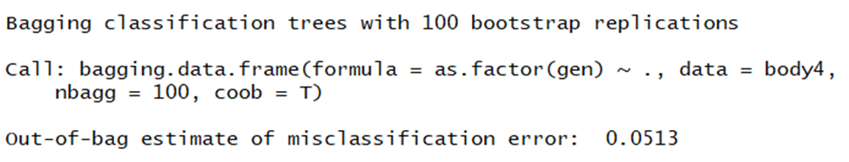
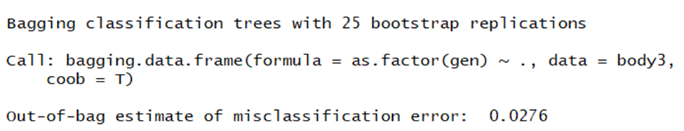
Bagging Analysis
N=25, OOB=5.72%
N=100,OOB=5.13%
Take PCA method, OOB=2.76%.

Slide 13
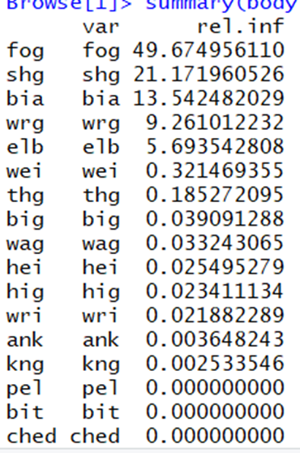
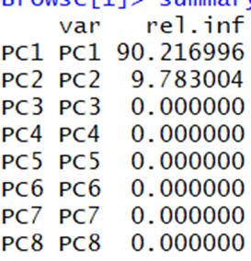
Boosting Analysis
N=100, APER=48.72%
N=500, APER=48.72%
Take PCA method,
N=100, APER=14.398%
N=500, APER=14%

Slide 14
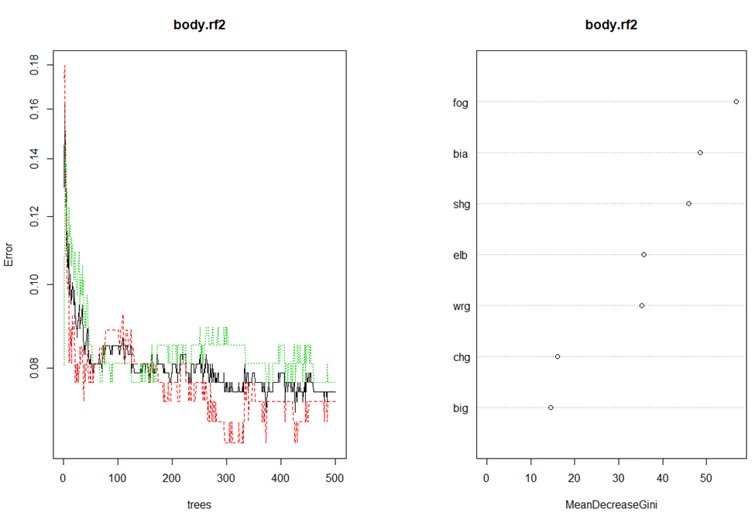
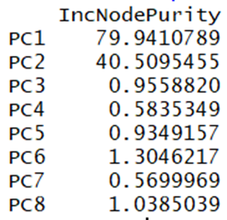
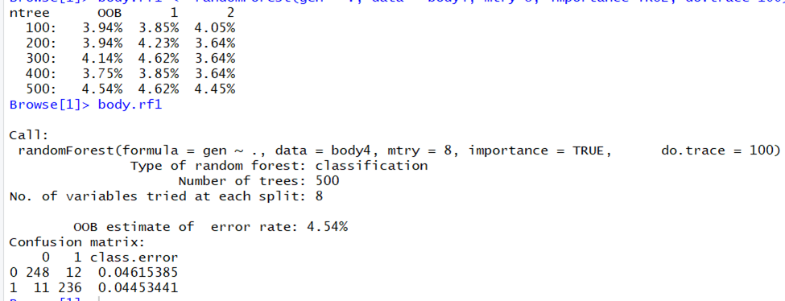
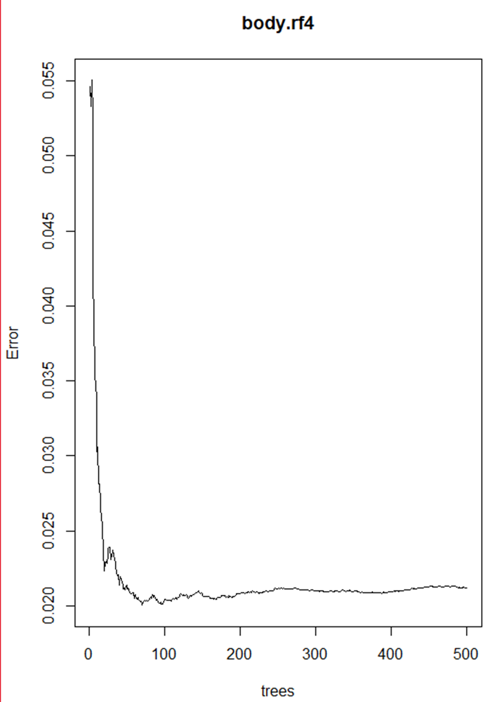
Random Forest Analysis
N=100, OOB=4.54%
N=400, OOB=3.75%
Take PCA method, APER=2.12%.

Slide 15
Compare all results
Methods | APER (PCA)
Logistic Regression | 1.78%
Linear Discriminant Analysis | 1.58%
Quadratic Discriminant Analysis | 1.78%
K-Nearest Neighbors | 5.23%
Classification Regression Tree | 2.213%
Bagging Analysis | 2.76%
Boosting Analysis | 14%
Random Forest Analysis | 2.12%
The linear discriminant analysis does perform the best of all models considered to the structure of this data in this kind of prediction.

Slide 16
Conclusion
Even though linear discriminant analysis, logistic regression and quadratic regression perform better than classification regression tree based on APER, CART model has the advantage of being much more interpretable with 8 components consisting of all 24 inputs. It’s obvious the PC1 and PC2 are the most significant splitter, which makes perfect sense. Given the key difference between males and females, the young adults have no much impact on the skeletal and girth measurements but the middle-aged or older adults do have some influence on body build dimensions in males and females.
As we expected, height variable affects the weight significantly and positively in males and females. In complete regression model, girth measurements account for larger percentage on weight as chest girth, waist girth, hip girth et al. are main parts in body build for designing. In logistic regression model, all input are no so statistically significant but waist girth, forearm girth, height and weight contribute much larger difference in two groups.
Moreover, with PCA method, the PC1,PC2,PC3 and PC5 take more contribution to separation in males and females where body build dimensions are different. Also, taking PCA method is more comprehensive for demonstrating the differentiation in males and females.

Slide 17
Thank You!

